Slide 1
Guided Truck Loading And Manual Routing
Screen 1
Deepak Bhatt
18 Oct 2012
Notes:
This template can be used as a starter file for presenting training materials in a group setting.
Sections
Right-click on a slide to add sections. Sections can help to organize your slides or facilitate collaboration between multiple authors.
Notes
Use the Notes section for delivery notes or to provide additional details for the audience. View these notes in Presentation View during your presentation.
Keep in mind the font size (important for accessibility, visibility, videotaping, and online production)
Coordinated colors
Pay particular attention to the graphs, charts, and text boxes.
Consider that attendees will print in black and white or grayscale. Run a test print to make sure your colors work when printed in pure black and white and grayscale.
Graphics, tables, and graphs
Keep it simple: If possible, use consistent, non-distracting styles and colors.
Label all graphs and tables.

Slide 2
Today’s Overview
Screen 2
a
b
Manage Appointment
C
Scan To Truck
Top Features
Manual Routing
Notes:
This is another option for an Overview slide.

Slide 3
Manual Routing
Screen 3
Notes:
Use a section header for each of the topics, so there is a clear transition to the audience.

Slide 4
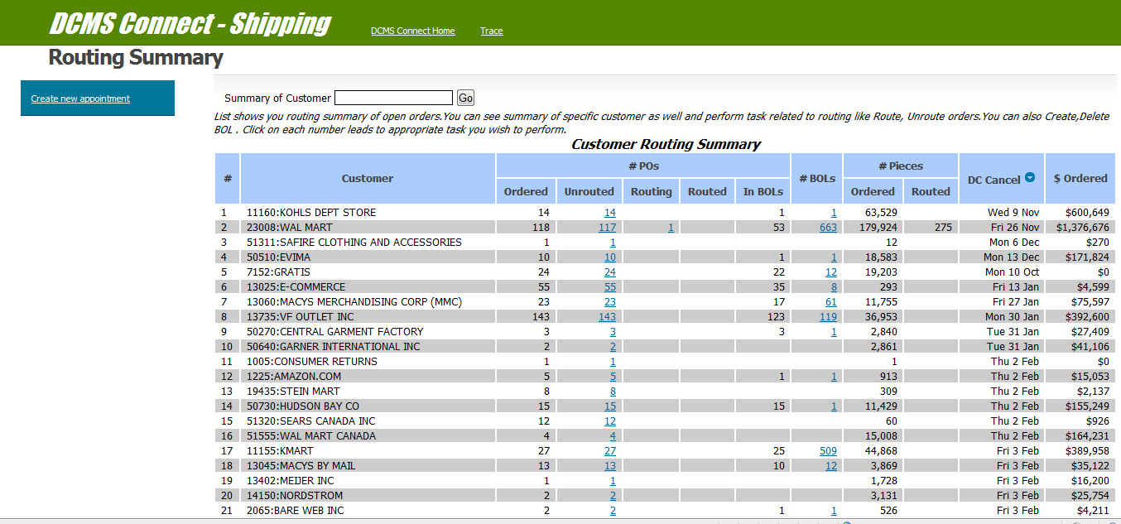
Screen 4
Routing Summary
Notes:
# Routing summary of open orders.
Shows total number of Urouted ,Routing and Routed orders , no of BOLs created. It also shows total pieces ordered and routed. List is sorted on DCCancel date. So you get to see orders which have cancel date near on the top.

Slide 5
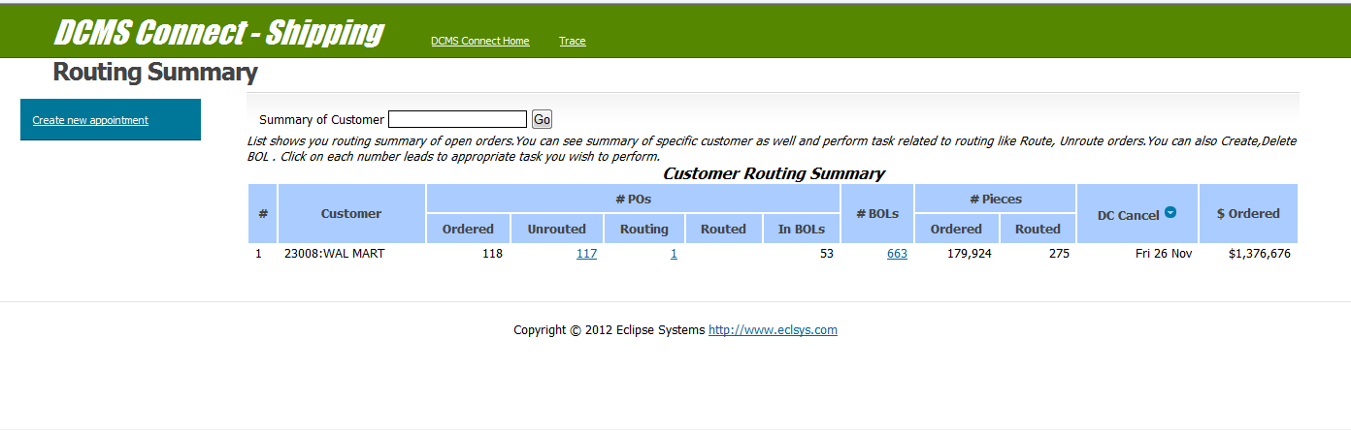
Screen 5
Routing Summary contd.
Notes:
You can see details of specific customer.
Click on highlighted numbers will lead you to appropriate screen.
e.g.:- Click on Unrouted no. takes you to screen where you can route orders.

Slide 6
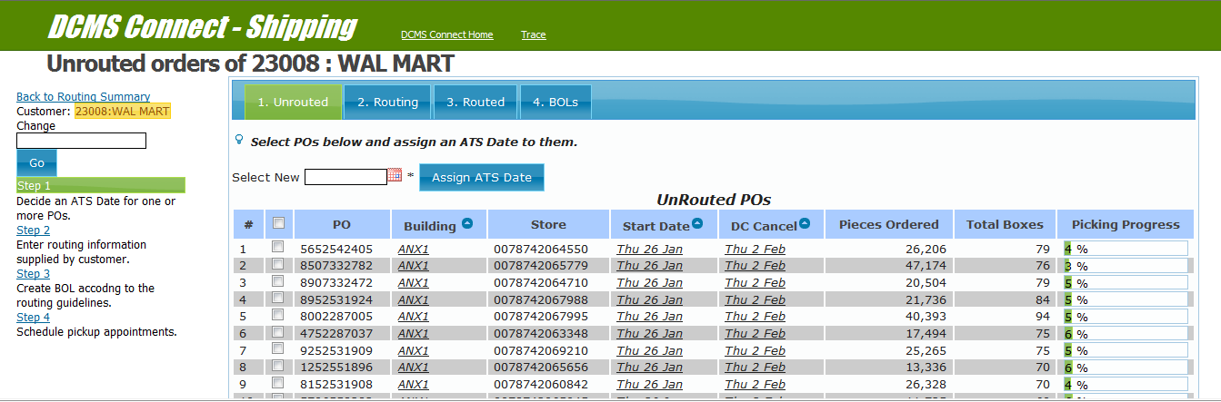
Screen 6
Un-routed orders
Notes:
You can filter orders on the basis of Building, Start date and DC Cancel Date.

Slide 7
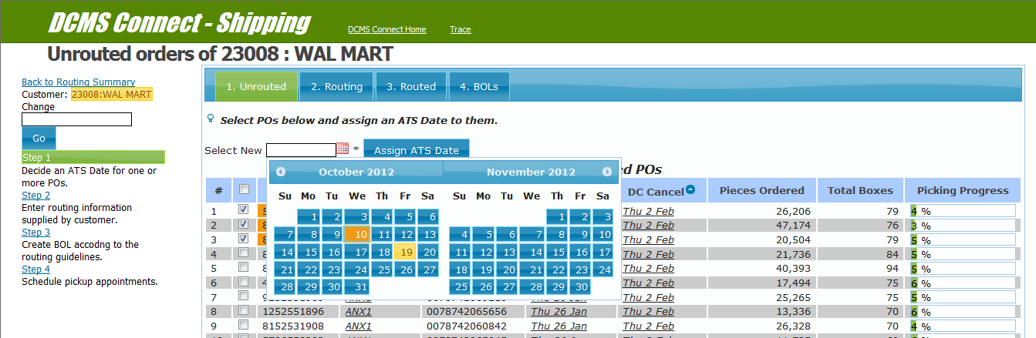
Screen 7
Un-routed orders contd.
Notes:
Select orders for routing and assign them an ATS date.
You can select existing ATS date as well.
Existing ATS dates displayed with orange color.

Slide 8
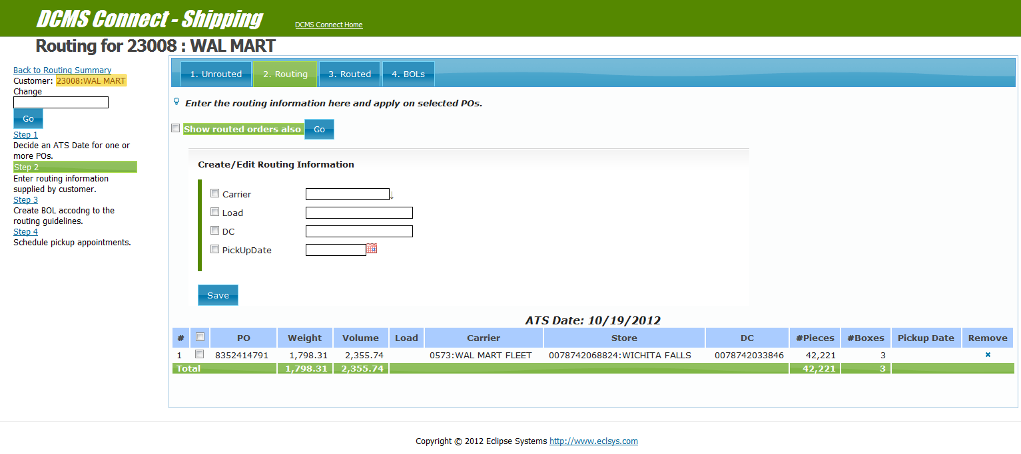
Screen 8
Routing
Notes:
Once ATS date is assigned to POs on un-routed screen, they become visible in Routing screen.
You can upload necessary routing info on customer’s website with the help of info provided by this screen.
By default this screen shows only those POs which have not been acknowledged by customer.
Use check box in upper left corner of screen to see all POs which have been assigned an ATS date.

Slide 9
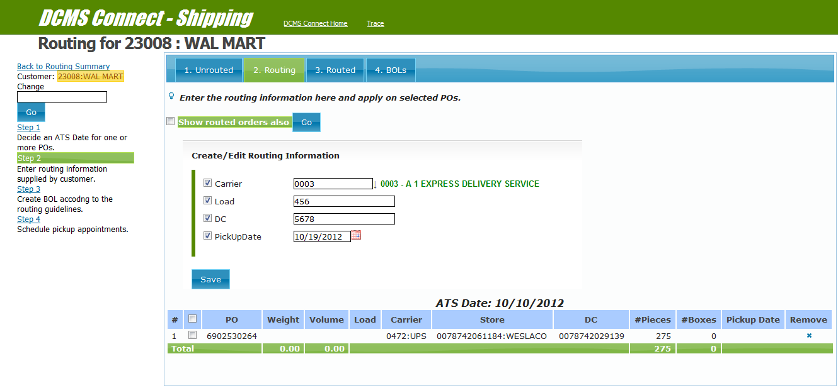
Screen 9
Routing contd.
Notes:
You can update routing info of each PO on the basis of info provided by customer.
e.g. carrier, Load, DC and Pick-Up date can be updated.

Slide 10
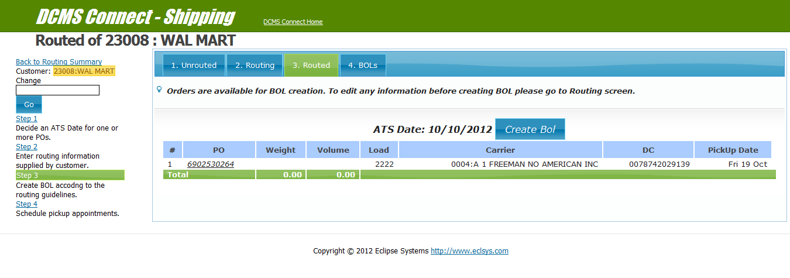
Screen 10
Routed Orders
Notes:
After necessary routing info has been provided in routing screen, orders become available in Routed screen.Here you can create BOL.

Slide 11
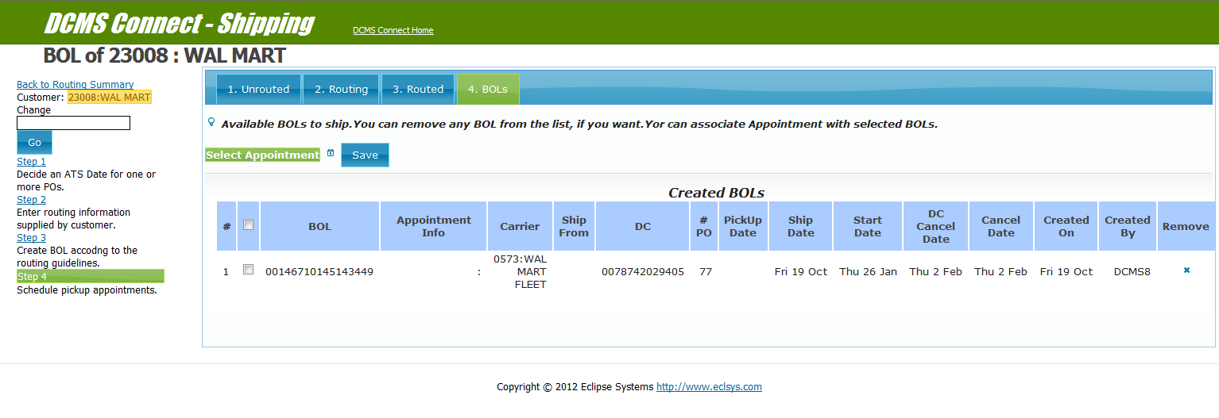
Screen 11
Bill of Lading
Notes:
This page show list of all un shipped BOLs of a customer.
You can associate an Appointment with the BOL. You can delete BOL as well.

Slide 12
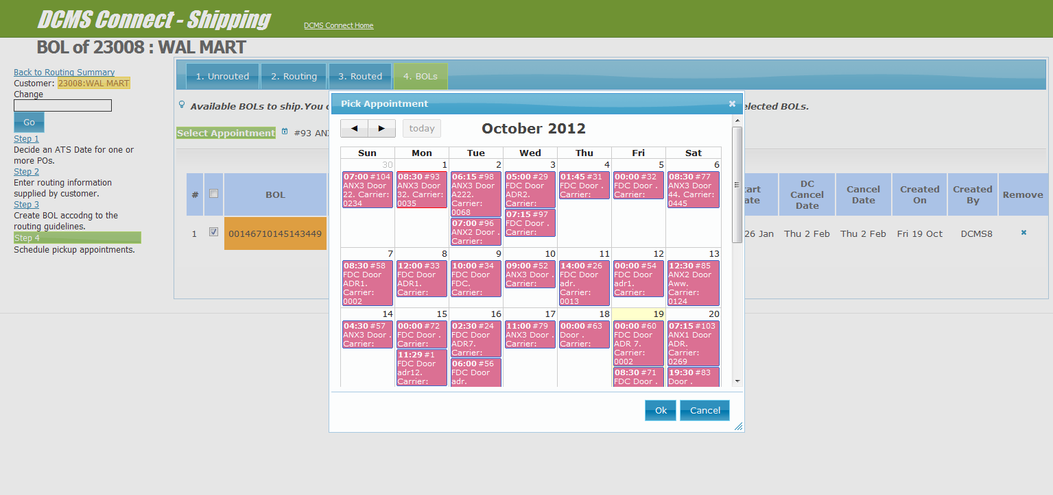
Screen 12
Associate appointments
Notes:
Select BOLs you wish to associate with an appointment.
Click on icon under Select Appointment to open an appointment picker.

Slide 13
Manage Appointment
Screen 13

Slide 14
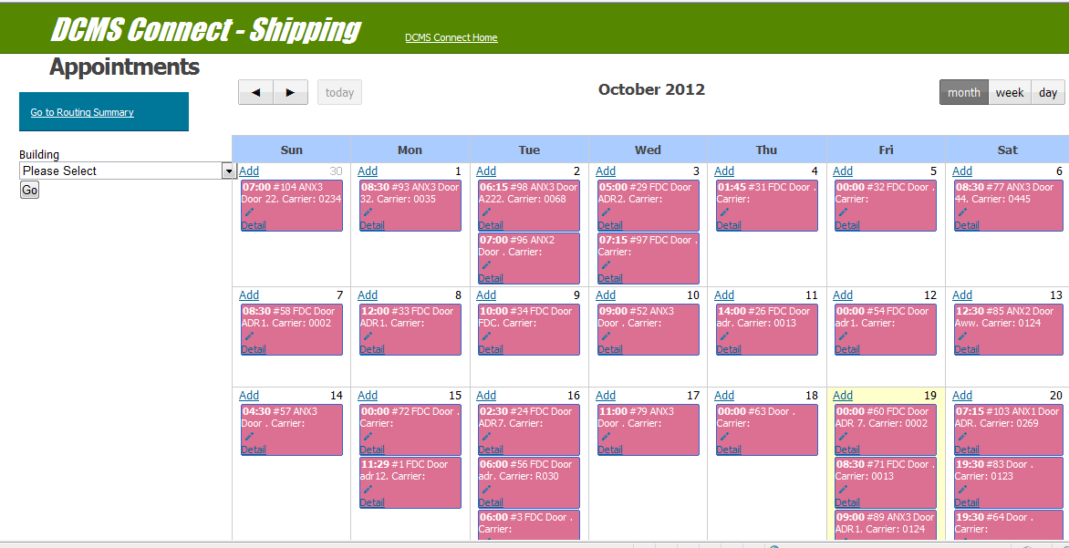
Screen 14
Appointments
Notes:
Screen shows appointments for the month.
You can see appointments of day or week by going to appropriate view.

Slide 15
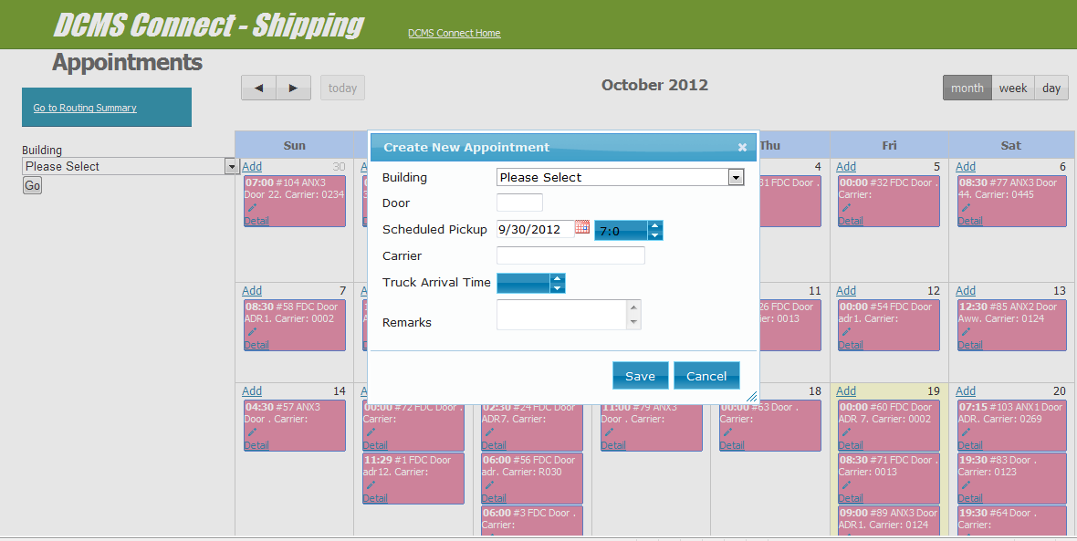
Screen 15
Creating Appointment
Notes:
Click on Add in left corner of each date opens a dialog to create a new appointment for that date.

Slide 16
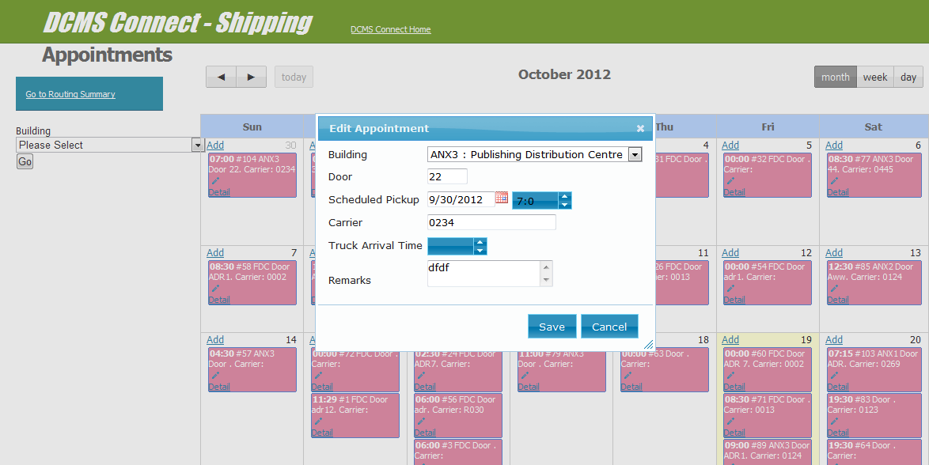
Screen 16
Creating appointment Contd.
Notes:
Click on edit icon to edit appointment info.
Click on detail takes you to screen which shows detail

Slide 17
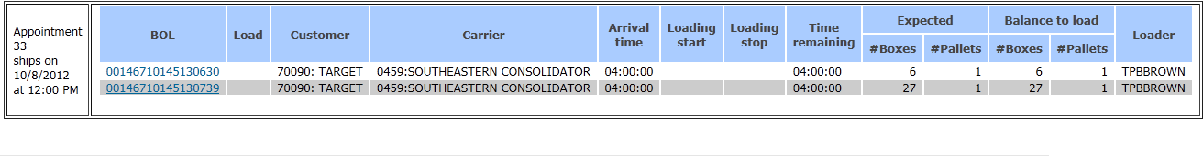
Screen 17
Appointment Progress
Notes:
Appointment detail shows BOLs associated with appointment.
Start and end time of each BOL on truck and various info related with load.

Slide 18
Scan To Truck
Screen 18
Notes:
Use a section header for each of the topics, so there is a clear transition to the audience.

Slide 19
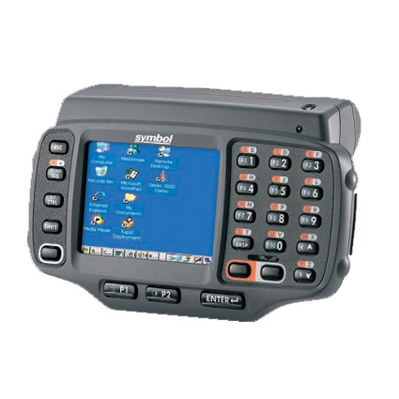
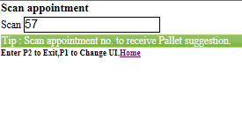
Scan To Truck
Screen 19
Trucker arrives at shipping office, he supplies the appointment number already assigned to him during appointment creation. Shipping supervisor pulls up appointment info from DCMS and directs the trucker to the appropriate gate to load the orders.
Notes:
Enter the appointment number in the UI

Slide 20
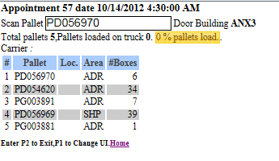
Scan To Truck
Screen 20
The screen displays summary information of the shipments to be loaded to the truck. This information includes the following.
Total Pallets which are to be shipped in the appointment.
Pallets loaded on truck.
Number of boxes which are not on any pallet.
Date and time of appointment.
Carrier details.
Loading progress.
Building.
Pick up door.
A few pallet suggestions are provided to get you started.
Loader scans a pallet in the screen and loads it to the truck.

Slide 21
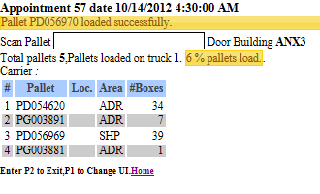
Screen 21
Scan To Truck
After you scan the pallet in the UI it displays the message that pallet has been successfully loaded.

Slide 22
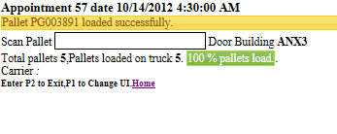
Screen 22
Scan To Truck
After all the pallets of the appointment has been loaded to the truck the UI indicates it by showing that 100% loading has been completed. ShipMgr now allows you to ship this order.

Slide 23
Questions ?
Screen 23

Slide 24
Thanks
Screen 24

